Slide 1
Transform Your popcorn sales
Earn All 8 to create Megacorn!

Slide 2
2017 popcorn Kernel meeting September 9, 2017

Slide 3
The How & the Why
Tonight we are going to show you how to sell popcorn and why it matters

Slide 4
Why is our Unit selling popcorn?

Slide 5
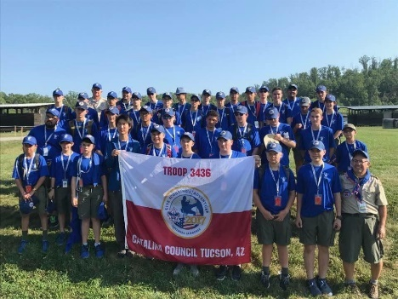
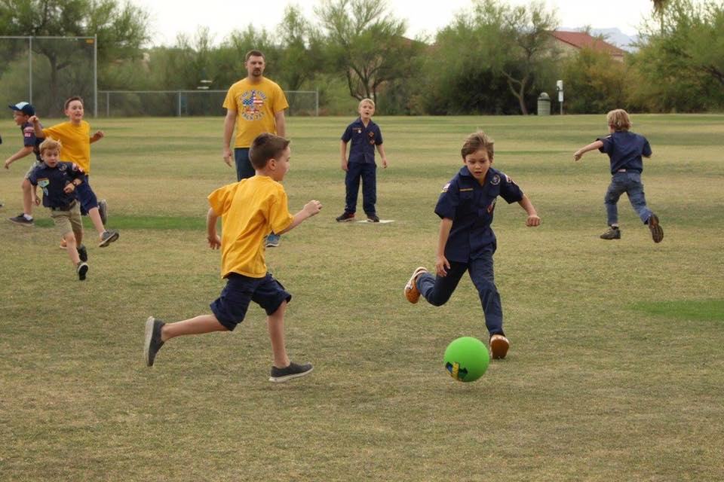
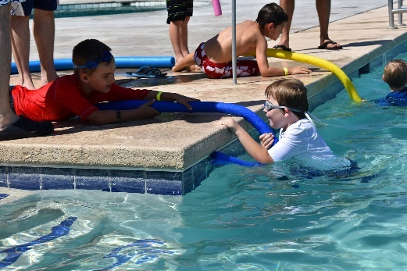
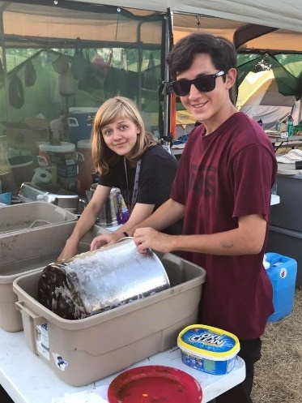
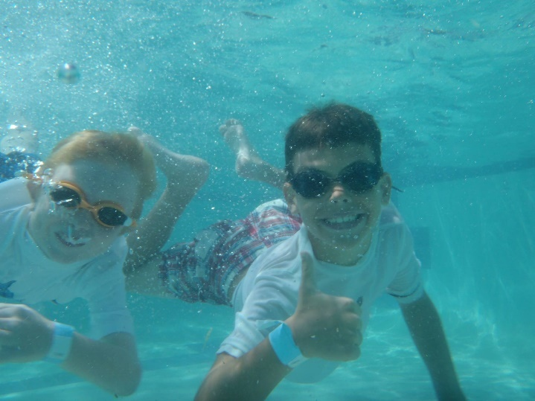
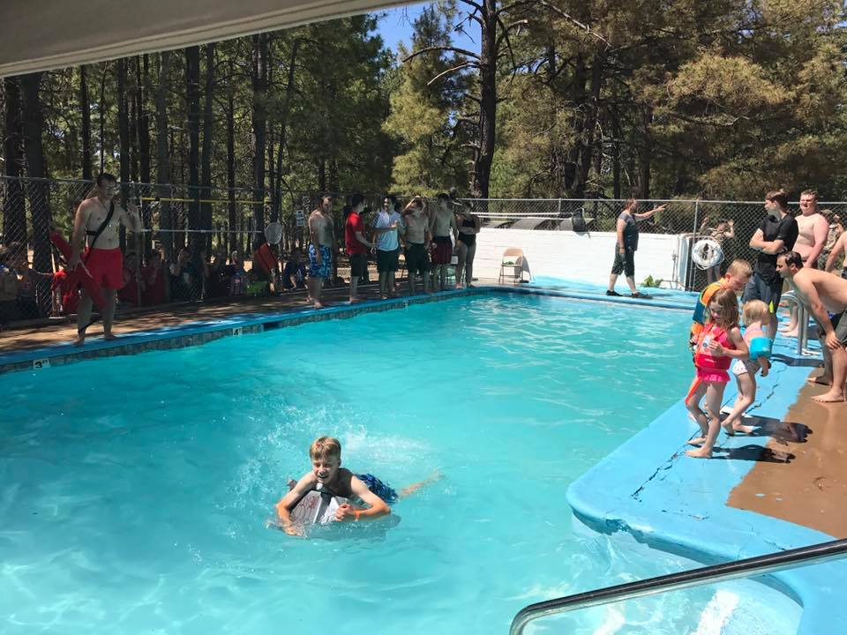
Popcorn = Program

Slide 6
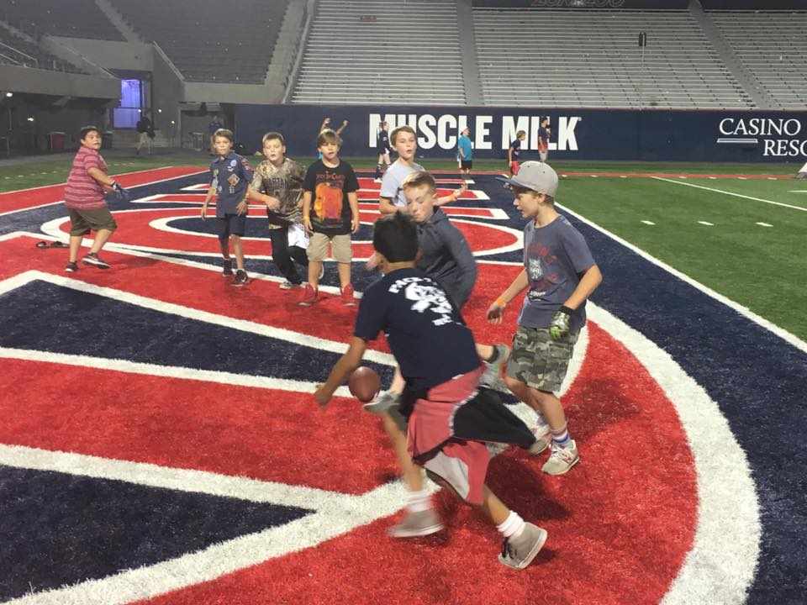
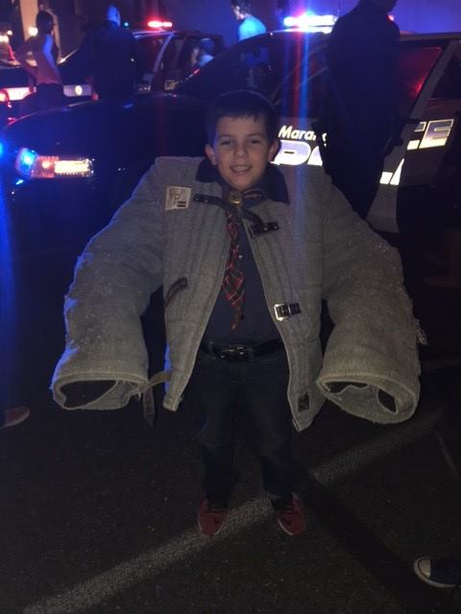
Program costs money
We have to raise the money needed to fund our 2017-18 scouting program

Slide 7
Prizes!

Slide 8
Our unit’S 2017-18 program
parents: what’s in it for you!

Slide 9
Handout
Our upcoming program and the cost$

Slide 10
Why your Scout should participate in popcorn sales?
He learns to “earn his own way”
Quality program for the entire unit
No out-of-pocket expense for parents!

Slide 11
Lets do some math! 20 Scouts: unit goal- $10,000 per-scout goal- $500
hit this – then your son’s scouting is free for the year!

Slide 12
Prizes!

Slide 13
How are we going to sell popcorn?
A few things to ensure selling success…

Slide 14
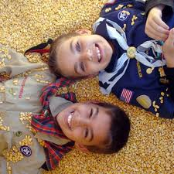
Scout Salesmanship
We have to take the proper approach
Let’s role-play!

Slide 15
Scout Salesmanship
Do not say “do you want to buy some popcorn?” right at the start
That gives the customer an easy way to say “no!”

Slide 16
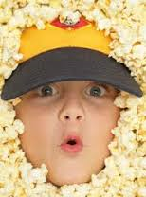
Scout Salesmanship
Instead, try this approach….
Hi! My name is ____.
We’re trying to fund our way to Cub camp by selling popcorn.
Will you help me?

Slide 17
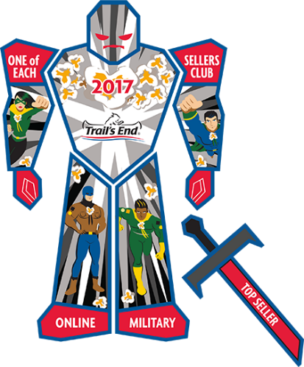
Prizes!

Slide 18
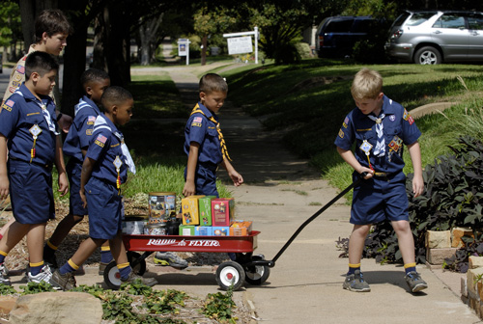
How = where to sell
Store front – show n sell
Door-to-door in your neighborhood
Parents’ office / workplace
Businesses in your area
Online at www.trails-end.com

Slide 19
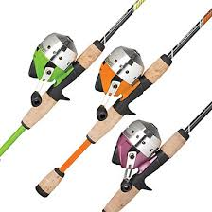
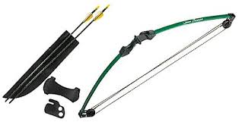
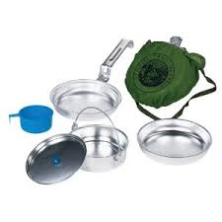
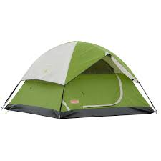
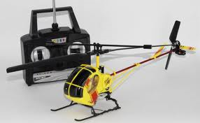
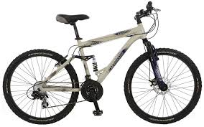
Who likes prizes?
Council-sponsored prize program
Goal-based extra incentives
Additional unit incentives
Trail’s end scholarship

Slide 20
Nuts & bolts of our sale
Campaign Dates
Commissions
Turn in orders and product pick-up

Slide 21
Prizes!

Slide 22
Have fun & good luck this fall!

